Slide 1
Auto Sklearn

Slide 2
Prerequisite
Python 3
Machine Learning Algorithms
Sklearn, Pandas library

Slide 3
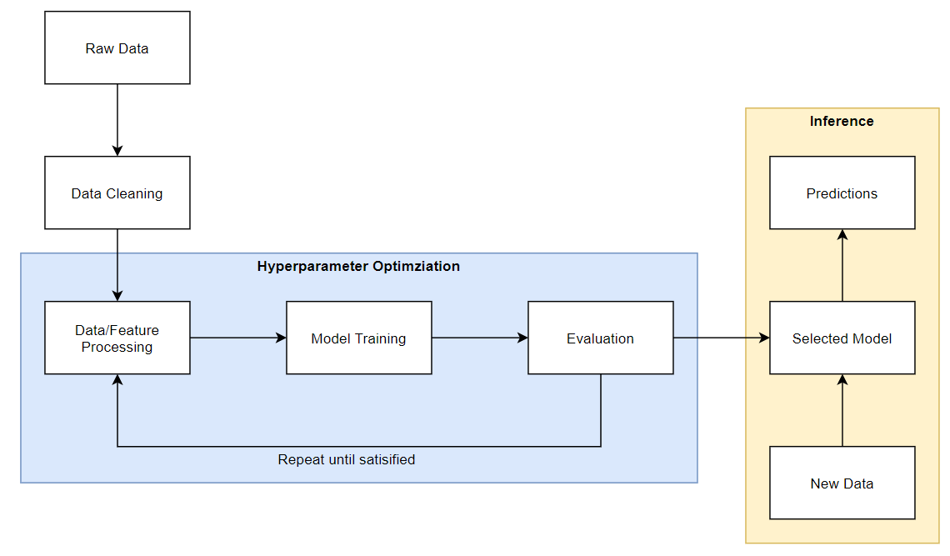
What is Auto-Sklearn?
A typical Machine Learning Workflow

Slide 4
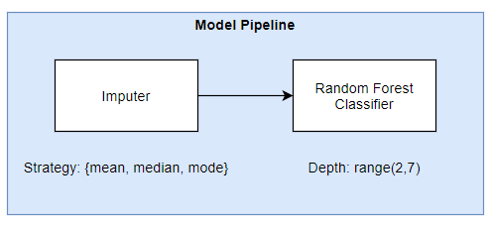
Hyperparameter Optimization
The objective of hyperparameter optimization is to find the optimal model pipeline components and their associated hyperparameters.

Slide 5
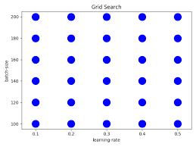
Grid Search
For each hyperparameter, we make a list of possible values and try all possible combinations of values.

Slide 6
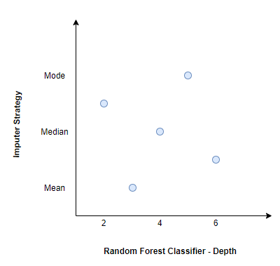
Random Search
In random search, we define the range and choices for each hyperparameter and the sets of hyperparameters are randomly chosen within these boundaries.

Slide 7
Bayesian Optimization
Bayesian optimization stores prior searched hyperparameters and results of a predefined objective function (e.g. binary cross entropy loss) and use it to create a surrogate model.
The purpose of a surrogate model is to quickly estimate the performance of the actual model given a particular set of candidate hyperparameter.
This allows us to decide if we should use the set of candidate hyperparameter to train the actual model with.
As the number of trials increases, the surrogate model, updated with additional trial results, improves and starts to recommend better candidate hyperparameters.
Bayesian optimization suffers from cold start problem as it requires trial data to build the surrogate model before it is able to recommend good candidate hyperparameter for the next trial.
To overcome the cold start problem, Auto-Sklearn, an open source AutoML library, incorporates warm start, through a process called meta-learning, into Bayesian optimization to get instantiation of hyperparameters that are better than random.

Slide 8
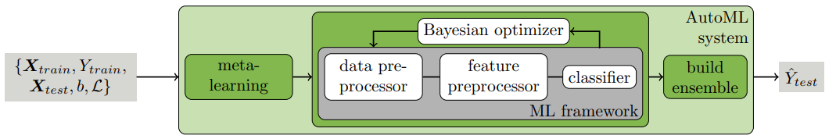
Auto-Sklearn
Automated Machine Learning (AutoML) is the process of automating tasks in the machine learning pipeline such as data preprocessing, feature preprocessing, hyperparameter optimization, model selection and evaluation.
Auto-Sklearn uses Bayesian optimization with warm start (meta-learning) to find the optimal model pipeline and build an ensemble from the individual model pipelines at the end.

Slide 9
Meta Learning
The purpose of meta-learning is to find good instantiation of hyperparameters for Bayesian optimization so that it performs better than random at the start.
The intuition behind meta learning is simple: datasets with similar meta features performs similarly on the same set of hyperparameter.
Meta features as defined by Auto-Sklearn authors are “characteristics of the dataset that can be computed efficiently and that help to determine which algorithm to use on a new dataset”.

Slide 10
THANK YOU

